Slide 1
Introduction to Monte Carlo Simulation in Finance
Simulating Interest Rates Derivatives Profiles for Counterparty Credit Risk Management
March 18, 2025

Slide 2
Table of contents
Section 1 Counterparty Credit Risk - Introduction 2
Section 2 Monte Carlo Simulations 12
Section 3 Modelling Counterparty Credit Risk 18
Section 4 Case Overview Revisited 23
Section 5 Modelling CCR for Interest Rates Products 25
Section 6 Backward Induction and American Monte-Carlo Methods 32

Slide 3
Section 1
Counterparty Credit Risk - Introduction

Slide 4



Counterparty Credit Risk - Introduction
UBS, and other IBs, trade derivatives with various counterparties worldwide;
Typical scenario:
Company XYZ issues $1bi of 15y bonds at fixed rate;
Company XYZ enters into a swap with UBS to transform its fixed rate liability into a floating one, ie, UBS pays fixed rate to XYZ Co. vs receiving floating for 15y in $1bi;
To hedge market risk, UBS enters into offsetting transactions with another Bank.
Company XYZ
Bank
Another bank
IRS
Hedging
BANKRUPT
What can go wrong?

Slide 5
Counterparty Credit Risk - Introduction
Expected loss – simple example
Example:
$100mio 5y loan to a company
Company has no tangible assets
Probability of default over next 5y is 5%
Expected Loss = EAD x PD x LGD
EAD: Exposure at Default
PD: Probability of Default
LGD: Loss Given Default
1/ What is the EAD?
2/ What is the LGD roughly?
For a corporate loan, it is easy to determine the EAD (Exposure at Default). But how can we do it for a portfolio of derivatives?

Slide 6
Counterparty Credit Risk - Introduction
Counterparty credit risk
Counterparty credit risk is a risk that a counterparty will not be able to meet its obligations (payments). It is different from the credit risk of bonds and loans.
The loss amount is not known until the time of bunkruptcy
The risk is typically bilateral, both parties take the risk.
Instruments generating counterparty risk:
OTC Derivatives
Financing transactions
forwards
swaps
CDS
European/American/Asian Options
repo
reverse repo
security lending
In financial institutions this risk impacts in particular two areas:
pricing and capital requirements.

Slide 7







Counterparty Credit Risk - Introduction
Credit exposure
We have a derivative X having value at time t.
If the counterparty defaults at time . Our loss is:
$$V_{X}(t)$$
$$0$$
$$V_{X}(τ)$$
$$V_{X}(τ)$$
Credit exposure at time t is the replacement value of the contract if it is positive and zero otherwise.
$$E_{X}(t)=max(V_{X}(t),0)$$
$$V_{X}(t)$$
We don’t know the future value of , the exposure is random!

Slide 8
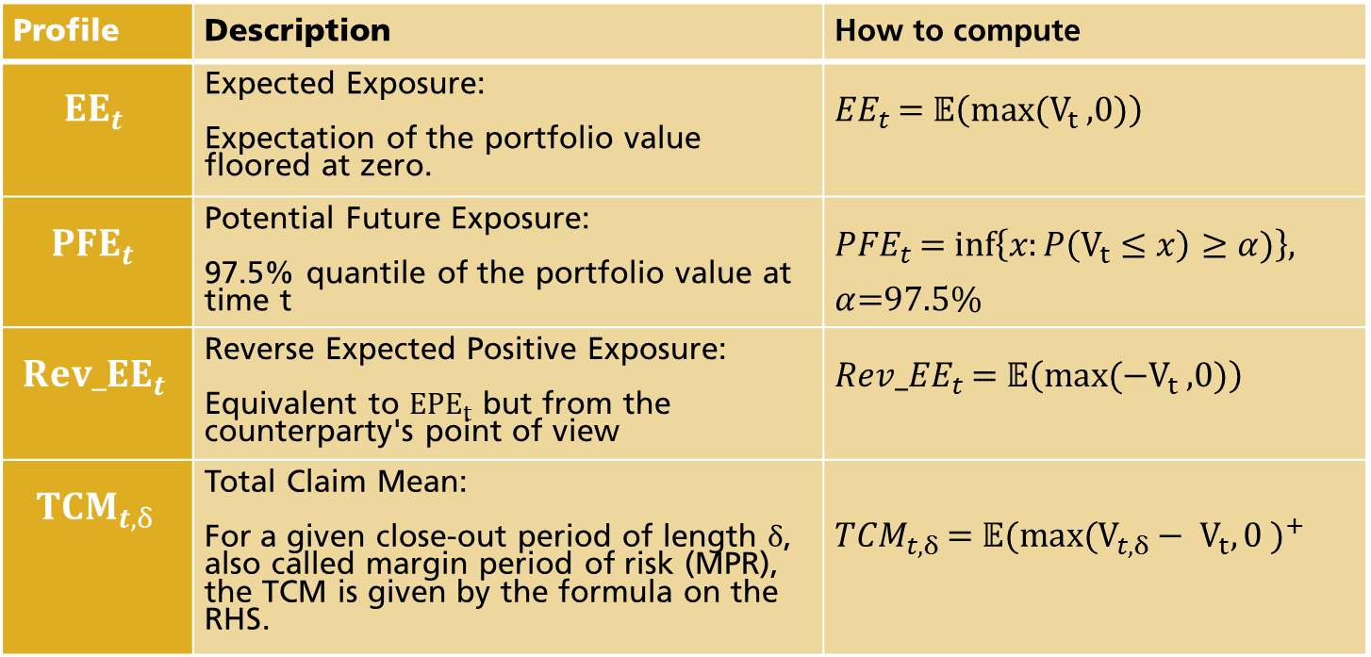
Counterparty Credit Risk - Introduction
Profiles’ definitions
Profile | Description | How to compute
$${EE}_{t}$$ | Expected Exposure: Expectation of the portfolio value floored at zero. | ${EE}_{t}$ = $𝔼\left(max⁡(V_{t} \text{,0)}\right)$
$${PFE}_{t}$$ | Potential Future Exposure: 97.5% quantile of the portfolio value at time t | ${PFE}_{t}$ = $inf\left\{x:P\left(V_{t}≤x\right)≥α)\right\}$, $α$=97.5%
$${Rev_EE}_{t}$$ | Reverse Expected Positive Exposure: Equivalent to ${EPE}_{t}$ but from the counterparty's point of view | ${Rev_EE}_{t}$ = $𝔼\left(max⁡(−V_{t} \text{,0)}\right)$
$${TCM}_{t,δ}$$ | Total Claim Mean: For a given close-out period of length $δ$, also called margin period of risk (MPR), the TCM is given by the formula on the RHS. | ${TCM}_{t, δ}$ = ${𝔼\text{(}\text{max}\text{(}V_{t, δ}− V_{t},0 )}^{+}$

Slide 9

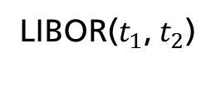

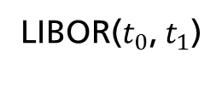


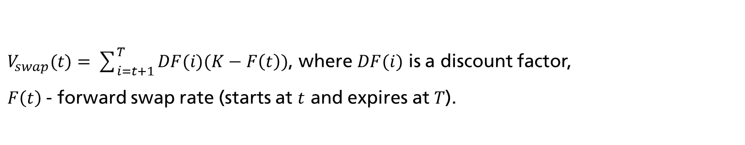
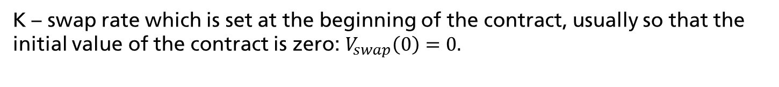


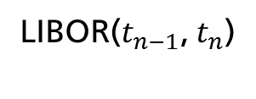
Counterparty Credit Risk - Introduction
Example (interest-rate swap)
Interest Rate Swap (IRS) is a contract, in which two counterparties to agree to exchange future interest payments.
K%
K%
K%
$$…$$
$$t_{0}$$
$$t_{1}$$
$$t_{2}$$
$$…$$
$$t_{n}=T$$
LIBOR($t_{0}$, $t_{1}$)
LIBOR($t_{1}$, $t_{2}$)
LIBOR($t_{n−1}$, $t_{n}$)
K – swap rate which is set at the beginning of the contract, usually so that the initial value of the contract is zero: $V_{swap}\left(0\right)=0.$
$V_{swap}(t)=\sum_{i=t+1}^{T}{DF(i)(K−F\left(t\right)})$, where $DF(i)$ is a discount factor,
$F\left(t\right)$- forward swap rate (starts at $t$ and expires at $T$).
Swaption is an option that gives its holder right to enter into a swap.

Slide 10

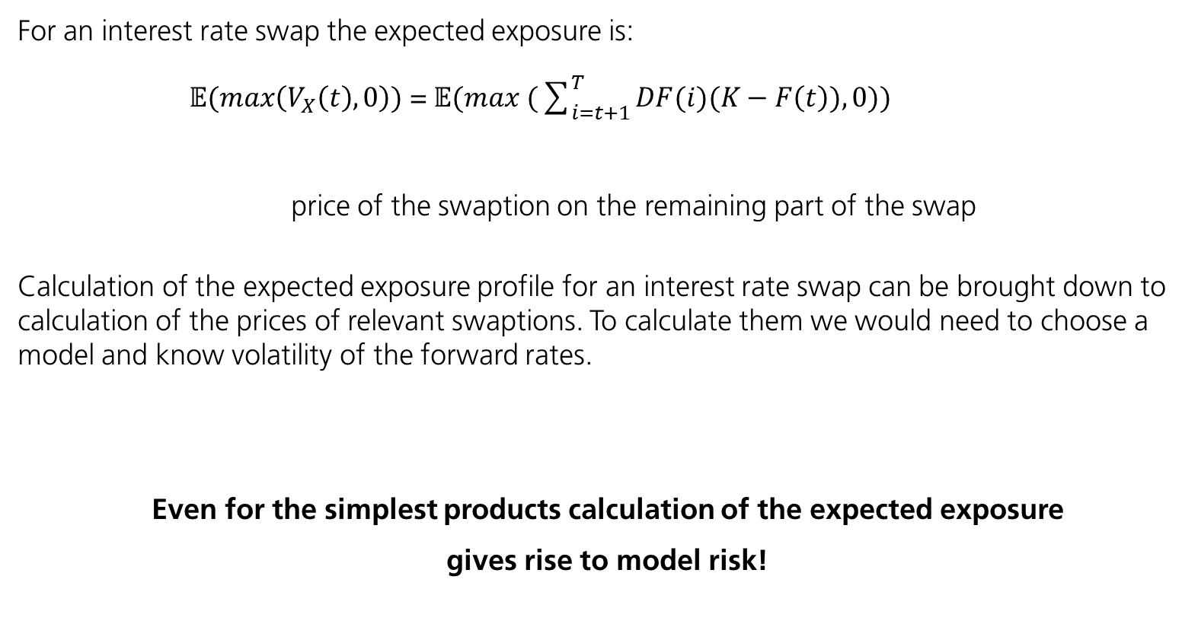
Counterparty Credit Risk - Introduction
Example (interest-rate swap) – cnt’d
For an interest rate swap the expected exposure is:
$𝔼(max\left(V_{X}\left(t\right),0\right))$ =$𝔼(max (\sum_{i=t+1}^{T}{DF(i})(K−F\left(t\right)),0))$
price of the swaption on the remaining part of the swap
Calculation of the expected exposure profile for an interest rate swap can be brought down to calculation of the prices of relevant swaptions. To calculate them we would need to choose a model and know volatility of the forward rates.
Even for the simplest products calculation of the expected exposure
gives rise to model risk!

Slide 11
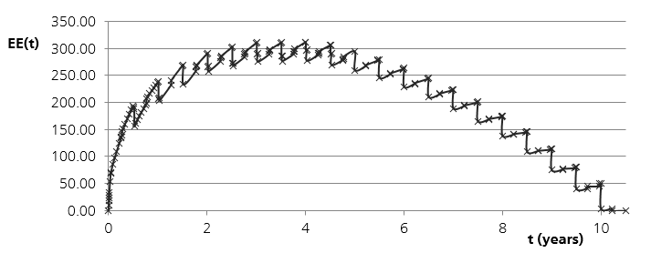
Counterparty Credit Risk - Introduction
Example exposure profile of an at-the-money interest-rate swap
For an at-the-money 10Y swap, where we receive fixed payments the EE profile looks as follows:
The shape of the profile is the results of combination of two effects :
Increasing uncertainty regarding the future cashflows,
Number of future cashflows, decreasing in time.

Slide 12
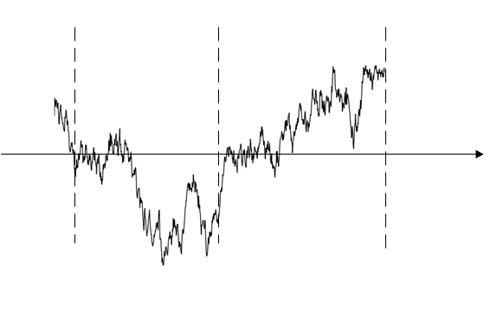
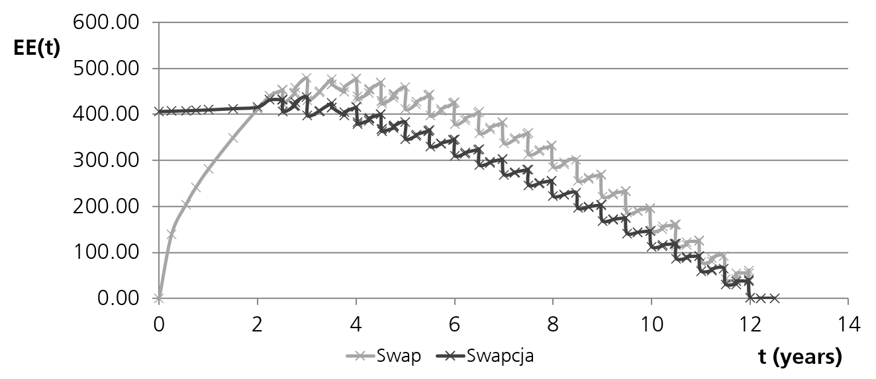
Counterparty Credit Risk - Introduction
Example expected exposure profile of an at-the-money interest-rate swaption
Exposure profile of a 2Yx10Y swaption
and the underlying forward swap:
swap value
time
t
option expiry
0
Until the expiry of the option its value is at least the intrinsic value.
After the expiry in some of the scenarios the option will not be exercised.

Slide 13
Section 4
Monte Carlo Simulations

Slide 14

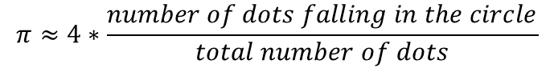



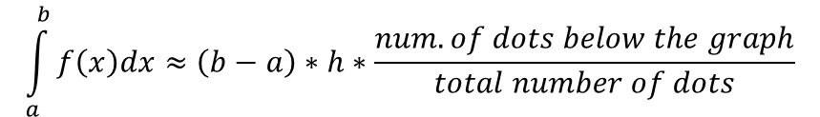

Monte Carlo Simulations
Monte Carlo methods - introduction
Monte Carlo methods – a class of algorithms that rely on repeated random sampling to obtain numerical results.
Some famous examples:
approximation of $π$
approximation of the value of an integral
$$h$$
$$f(x)$$
$$a$$
$$b$$
$$π≈4∗\frac{number of dots falling in the circle}{total number of dots}$$
$$\int_{a}^{b}{f\left(x\right)dx}≈\left(b−a\right)∗h∗\frac{num. of dots below the graph}{total number of dots}$$

Slide 15
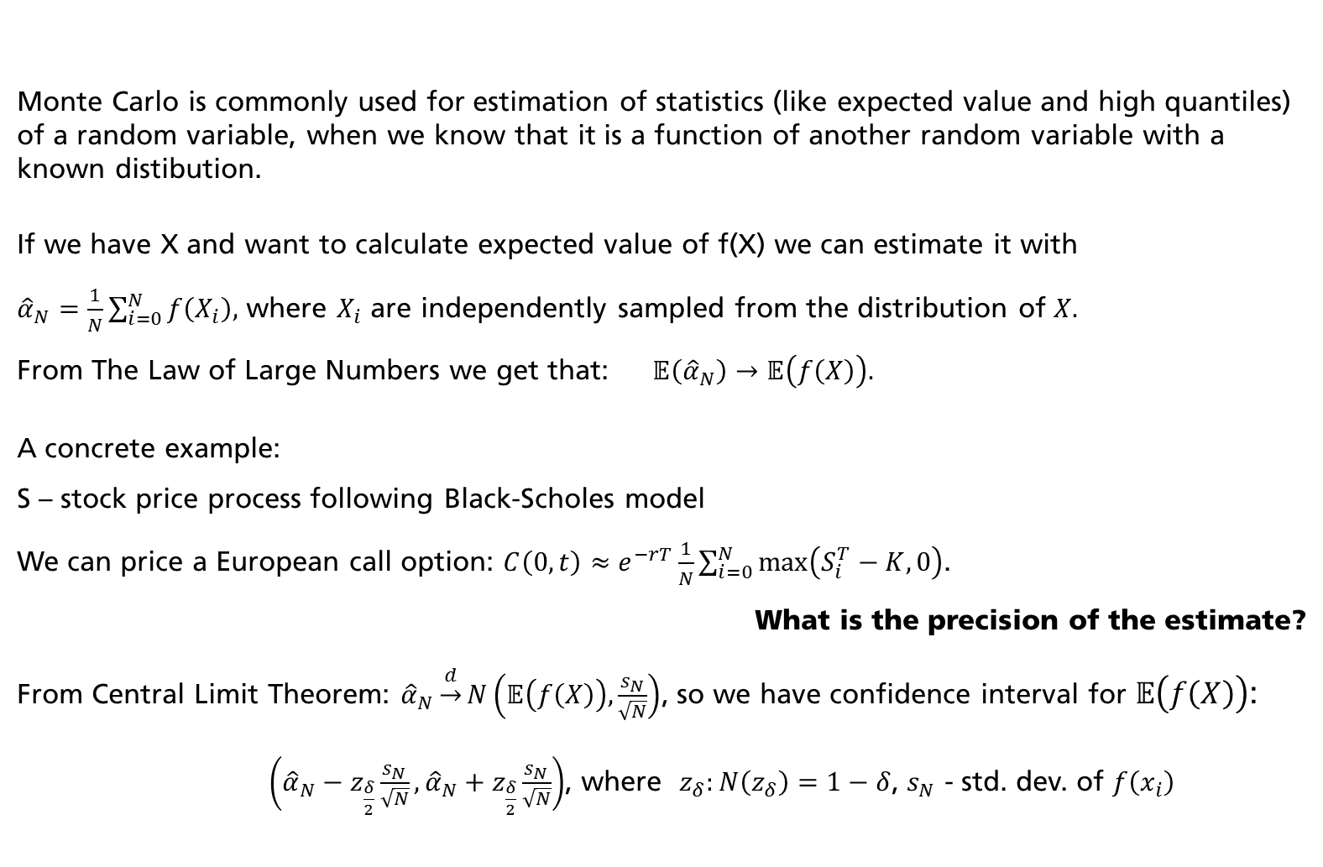
Monte Carlo Simulations
Monte Carlo is commonly used for estimation of statistics (like expected value and high quantiles) of a random variable, when we know that it is a function of another random variable with a known distibution.
If we have X and want to calculate expected value of f(X) we can estimate it with
${\hat{α}}_{N}=\frac{1}{N}\sum_{i=0}^{N}{f\left(X_{i}\right),}$ where $X_{i}$ are independently sampled from the distribution of $X.$
From The Law of Large Numbers we get that: $𝔼\left({\hat{α}}_{N}\right)→𝔼\left(f\left(X\right)\right).$
A concrete example:
S – stock price process following Black-Scholes model
We can price a European call option: $C\left(0,t\right)≈e^{−rT}\frac{1}{N}\sum_{i=0}^{N}{\max\left(S_{i}^{T}−K,0\right)}$.
What is the precision of the estimate?
From Central Limit Theorem: ${\hat{α}}_{N}\underset{→}{d}N\left(𝔼\left(f\left(X\right)\right),\frac{s_{N}}{\sqrt{N}}\right)$, so we have confidence interval for $𝔼\left(f\left(X\right)\right)$:
$\left({\hat{α}}_{N}−z_{\frac{δ}{2}}\frac{s_{N}}{\sqrt{N}},{\hat{α}}_{N}+z_{\frac{δ}{2}}\frac{s_{N}}{\sqrt{N}}\right)$, where $z_{δ}:N\left(z_{δ}\right)=1−δ$, $s_{N}$ - std. dev. of $f\left(x_{i}\right)$
Monte Carlo methods – introduction cnt’d

Slide 16








Monte Carlo Simulations
Stochastic process path generation example
We need to generate the whole paths for:
Pricing of path-dependent derivatives (Asian options, American options, barriers, …)
Pricing in short rate models
Calculation of the exposure profiles
Let $t_{0}=0<t_{1}< …<t_{n}=T,$
$$…$$
$$t_{0}$$
$$t_{1}$$
$$t_{2}$$
$$…$$
$$t_{n}=T$$
The stock price process in Black-Scholes model:
$$dS\left(t\right)=rS\left(t\right)dt+σ S\left(t\right)dW\left(t\right), S\left(0\right)=S_{0}$$
The solution is:
$$S\left(t\right)=S_{0}exp\left\{\left(r−\frac{1}{2}σ^{2}\right)t+σW(t)\right\}⁡, S\left(0\right)=S_{0}$$

Slide 17
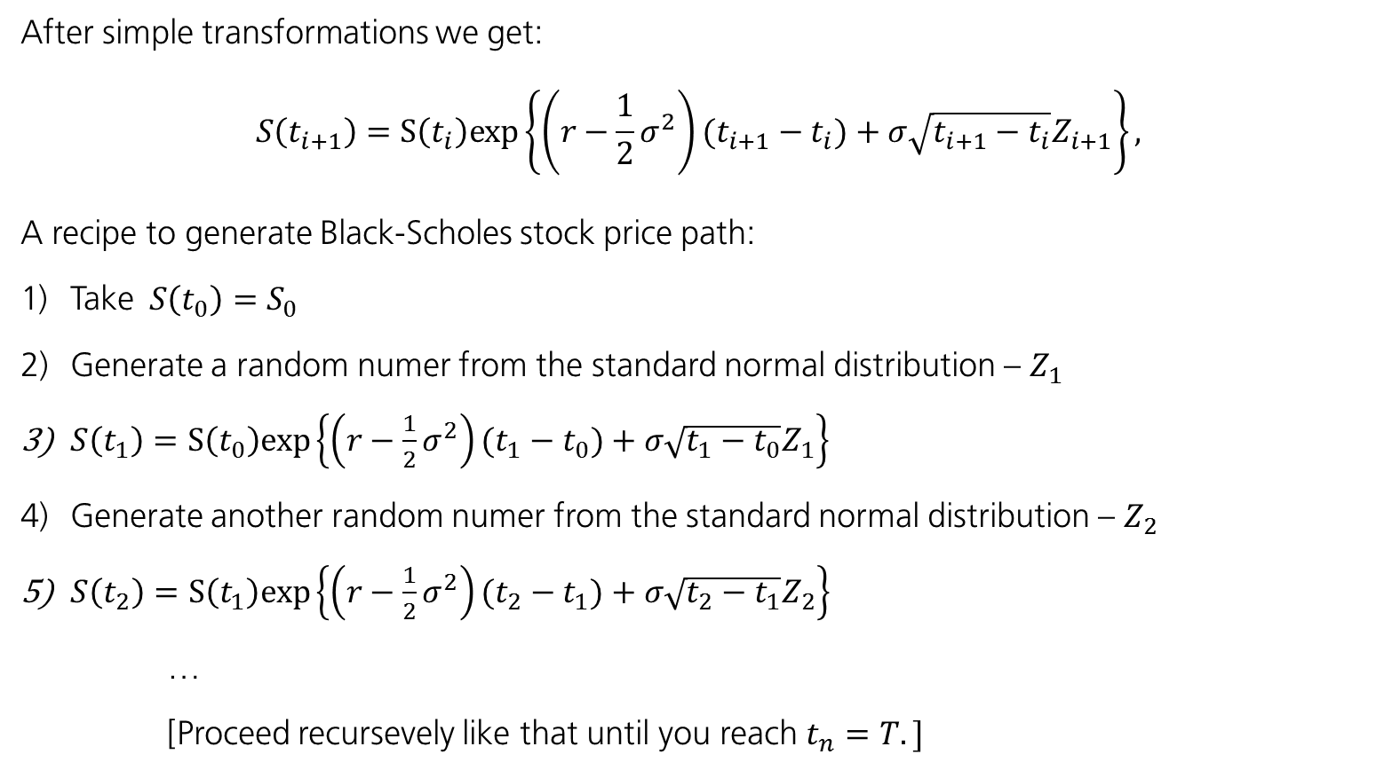
Monte Carlo Simulations
Stochastic process path generation example cnt’d
After simple transformations we get:
$$S\left(t_{i+1}\right)=S\left(t_{i}\right)exp\left\{\left(r−\frac{1}{2}σ^{2}\right)(t_{i+1}−t_{i})+σ\sqrt{t_{i+1}−t_{i}}Z_{i+1}\right\}⁡,$$
A recipe to generate Black-Scholes stock price path:
Take$S\left(t_{0}\right)=S_{0}$
Generate a random numer from the standard normal distribution – $Z_{1}$
$S\left(t_{1}\right)=S\left(t_{0}\right)exp\left\{\left(r−\frac{1}{2}σ^{2}\right)(t_{1}−t_{0})+σ\sqrt{t_{1}−t_{0}}Z_{1}\right\}$
Generate another random numer from the standard normal distribution – $Z_{2}$
$S\left(t_{2}\right)=S\left(t_{1}\right)exp\left\{\left(r−\frac{1}{2}σ^{2}\right)(t_{2}−t_{1})+σ\sqrt{t_{2}−t_{1}}Z_{2}\right\}$
…
[Proceed recursevely like that until you reach $t_{n}=T.]$

Slide 18
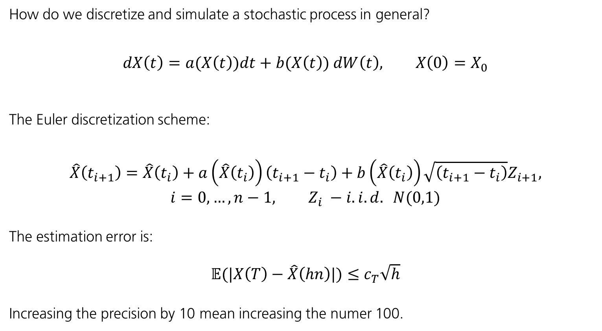
Modelling Counterparty Credit Risk
Stochastic process path generation – general recipe
How do we discretize and simulate a stochastic process in general?
$$dX\left(t\right)=a(X\left(t\right))dt+b(X\left(t\right)) dW\left(t\right), X\left(0\right)=X_{0}$$
The Euler discretization scheme:
$$\hat{X}\left(t_{i+1}\right)=\hat{X}\left(t_{i}\right)+a\left(\hat{X}\left(t_{i}\right)\right)\left(t_{i+1}−t_{i}\right)+b\left(\hat{X}\left(t_{i}\right)\right)\sqrt{\left(t_{i+1}−t_{i}\right)}Z_{i+1},$$
$$i=0,…,n−1, Z_{i} −i.i.d. N(0,1)$$
The estimation error is:
$𝔼(|X\left(T\right)−\hat{X}\left(hn\right)|)≤$ $c_{T}\sqrt{h}$
Increasing the precision by 10 mean increasing the numer 100.

Slide 19
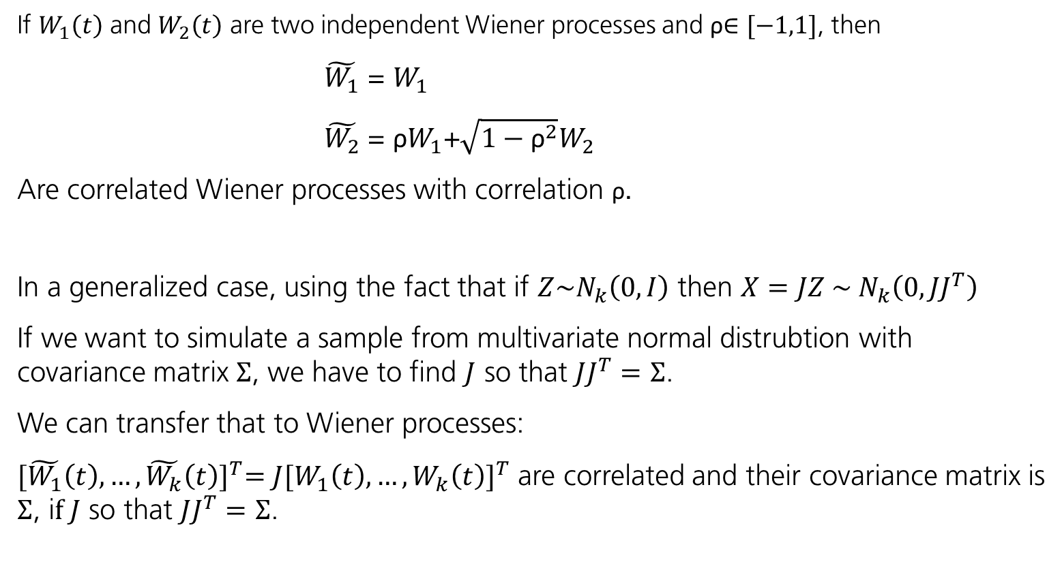
Modelling Counterparty Credit Risk
Simulation of correlated processes
If $W_{1}\left(t\right)$ and $W_{2}\left(t\right)$ are two independent Wiener processes and ρ$∈[−1,1]$, then
$\tilde{W_{1}}$ = $W_{1}$
$\tilde{W_{2}}$ = ${\text{ρ}W}_{1}$+$\sqrt{1−{\text{ρ}}^{2}}W_{2}$
Are correlated Wiener processes with correlation ρ.
In a generalized case, using the fact that if $Z\sim N_{k}\left(0,I\right)$ then $X=JZ \sim { N}_{k}\left(0,JJ^{T}\right)$
If we want to simulate a sample from multivariate normal distrubtion with covariance matrix $Σ$, we have to find $J$ so that $JJ^{T}=$ $Σ$.
We can transfer that to Wiener processes:
${[\tilde{W_{1}}\left(t\right),…,\tilde{W_{k}}\left(t\right)]}^{T}={J[W_{1}\left(t\right),…,W_{k}\left(t\right)]}^{T}$ are correlated and their covariance matrix is $Σ$, i$f J$ so that $JJ^{T}=$ $Σ$.

Slide 20
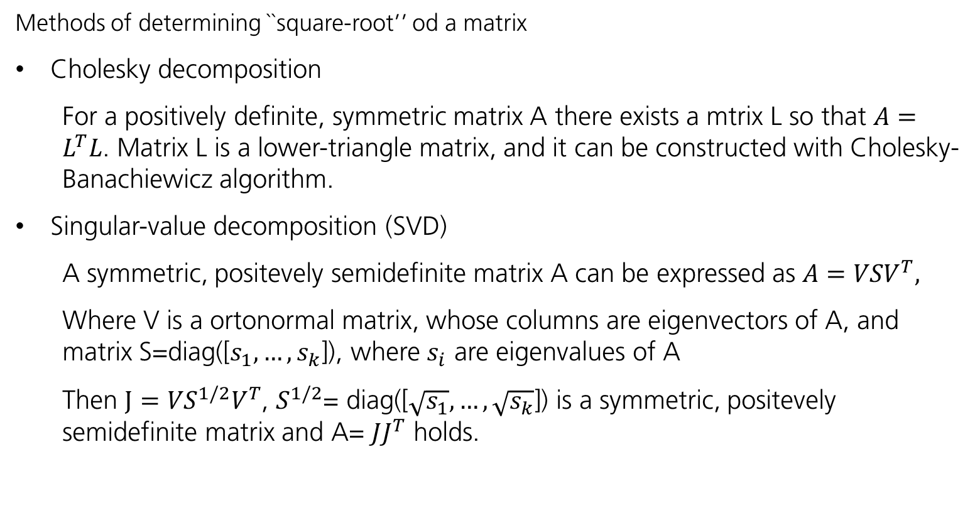
Modelling Counterparty Credit Risk
Simulation of correlated processes
Methods of determining ``square-root’’ od a matrix
Cholesky decomposition
For a positively definite, symmetric matrix A there exists a mtrix L so that $A=L^{T}L$. Matrix L is a lower-triangle matrix, and it can be constructed with Cholesky-Banachiewicz algorithm.
Singular-value decomposition (SVD)
A symmetric, positevely semidefinite matrix A can be expressed as $A={VSV}^{T},$
Where V is a ortonormal matrix, whose columns are eigenvectors of A, and matrix S=diag([$s_{1},…, s_{k}$]), where $s_{i}$ are eigenvalues of A
Then $J={VS}^{1/2}V^{T}$, $S^{1/2}$= diag([$\sqrt{s_{1}},…,\sqrt{s_{k}}$]) is a symmetric, positevely semidefinite matrix and A= $JJ^{T}$ holds.

Slide 21
Section 3
Modelling Counterparty Credit Risk

Slide 22
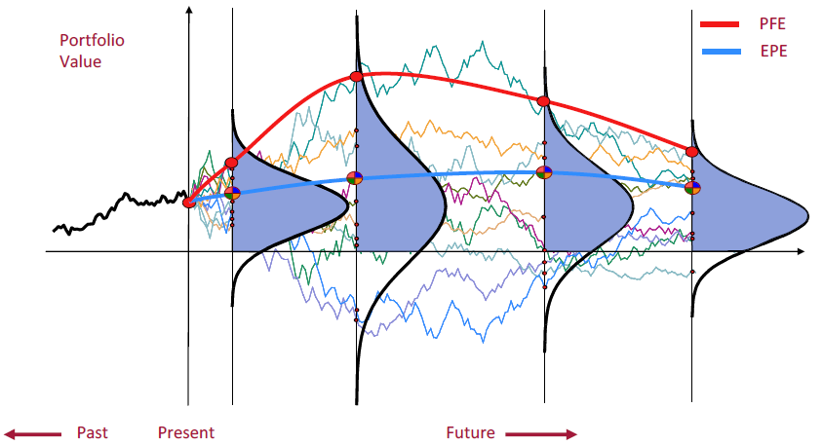
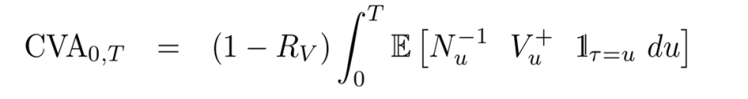
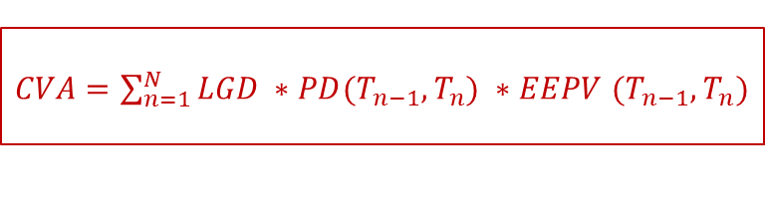
Modelling Counterparty Credit Risk
Expected Loss in the context of derivatives
We can simulate the evolution of the portfolio value over time
Potential Future Exposure (PFE): 97.5% quantile
Expected Positive Exposure (EPE): Average with values floored at 0
The equivalent of Expected Loss in derivatives world is called CVA (Credit Valuation Adjustments):
LGD
EAD part
PD part
Present Value of EPE
$CVA=\sum_{n=1}^{N}{LGD ∗PD(T_{n−1},T_{n})} ∗EEPV$ $(T_{n−1},T_{n})$
approx.

Slide 23
Modelling Counterparty Credit Risk
General CCR Modelling Recipe
Goal | Obtain risk profiles (EPE, PFE) for a given portfolio in order to compute CVA, RWA and regulatory capital.
Recipe | Choose a suitable risk factor model Calibrate the model Generate simulated paths, ie, simulate a variable of interest, eg.: short rate, stock price, spot FX; Price the portfolio Compute profiles Compute measures like CVA, FVA, RWA, Regulatory Capital

Slide 24
Modelling Counterparty Credit Risk
Challenges
The task of the computation of the exposure profiles for a derivative portfolio seems analogous to Value-at-Risk calculation but can be far more complicated due to :
far longer time horizon (often 30Y and beyond)
the risk-mitigants involved (netting, collateral, break clauses)
250 counterparties
40 transactions on average
100 simulation steps
10,000 scenarios
10 bln revaluations!
Efficiency of computation
is very important
Algorithms and models involved | Correlated random number generation (SVD, Cholesky Decomposition) Calibration – Bootstrapping, Minimum Squared Error, Closed Form Pricing Pricing Backward Induction / AMC

Slide 25
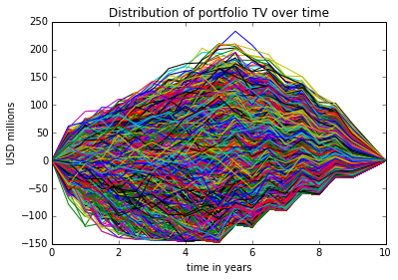
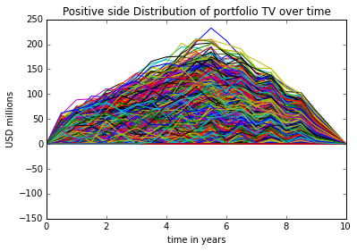
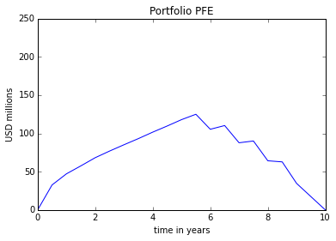
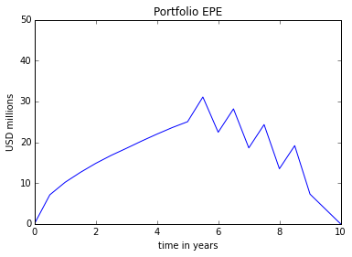
Modelling Counterparty Credit Risk
Portfolio Simulation
Portfolio of Derivatives
Bank
Counterparty

Slide 26
Section 4
Case Overview Revisited

Slide 27
Case Overview Revisited
What is our goal?
Calculate Risk Weighted Assets for the Bank using the Internal Model approach for three counterparties (Salzburg Bank, Bank of Cluj, Bank of Mazowsze) as of 23rd February 2018. Assume the notional for all trades is 1.000.000.000 USD.
Portfolios:
Saltzburg Bank of Tyrol (ID)(netted) :
1y Call Option on SPDRM striked at 95 USD
Bank of Cluj (ID)(non netted):
6m Call Asian Option on IRNMN striked at 570 USD
Bank of Mazowsze (ID)(netted):
1.5y Call American Option on AVNG striked at 4100 USD
2y Put Option on SPDRM striked at 115 USD
1.5y Put Asian Option on IRNMN striked at 450 USD
9m Put Asian Option on AVNG striked at 4100 USD
* Any relations to the real tickers is purely coincidental

Slide 28
Section 6
Backward Induction and American Monte-Carlo Methods

Slide 29
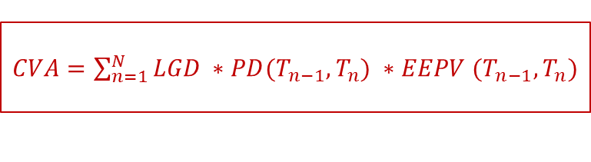
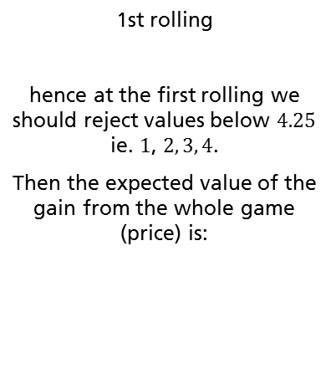
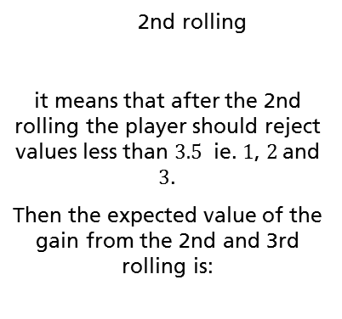


Backward Induction and American Monte-Carlo Methods
Backward induction – 1st example
Let's consider a game where we roll a fair die three times. After the first and the second draw
we can get a payoff equal to the number drawn or have a chance to roll the die one more time
(forgeting about the previous result). If we choose to roll for the third time we get the result
of the third rolling.
How do you assess what is the fair price for entering into the game?
At what level drawn the first or second time you should stop rolling and exercise the payoff
and at what level you should continue rolling?
Using backward induction:
3rd rolling
we know that in the 3rd rolling if it happens the expected value is:
2nd rolling
it means that after the 2nd rolling the player should reject values less than $3.5$ ie. $1$, $2$and $3$.
Then the expected value of the gain from the 2nd and 3rd rolling is:
1st rolling
hence at the first rolling we should reject values below $4.25$ ie. $1$, $2, 3, 4$.
Then the expected value of the gain from the whole game (price) is:
$$\frac{1}{6}\sum_{i=1}^{6}{i}=$$
$$\frac{1}{6}\left(1+2+3+4+5+6\right)=3.5$$
$$\frac{1}{6}\sum_{i=1}^{6}{max⁡(i,4.25)}=$$
$$\frac{1}{6}\left(4.25+4.25+4.25+4.25+5+6\right)=$$
$$4.66$$
$$\frac{1}{6}\sum_{i=1}^{6}{max⁡(i,3.5)}=$$
$$\frac{1}{6}\left(3.5+3.5+3.5+4+5+6\right)=4.25$$

Slide 30


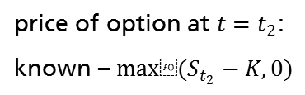




















Backward Induction and American Monte-Carlo Methods
Backward induction – binomial tree
Example: stock price evolution – 2-step binomial tree
$$p$$
$$S_{0}u^{2}$$
$$p$$
$$S_{0}u$$
$$1−p$$
$$S_{0}$$
$$1−p$$
$$p$$
$$S_{0}ud$$
$$S_{0}d$$
$$1−p$$
$$S_{0}d^{2}$$
$$t=t_{0}=0$$
$$t=t_{1}$$
$$t=t_{2}$$
European option pricing (call with expiry $t_{2}$, strike K)
option price at $t=0$
price of option at $t=t_{1}$:
$$V_{t}=E\left(e^{−r∆t}H\left(t_{2}\right) | F_{t_{1}}\right)$$
price of option at $t=t_{2}$:
known – $max⁡(S_{t_{2}}−K,0)$
$$p$$
$${V_{t_{2}}}_{}^{uu}=max⁡(S_{0}u^{2}−K,0)$$
$$p$$
${{V_{t_{1}}}_{}^{u}=e}^{−r∆t}[{pH}_{uu}+(1−p)H_{ud}$]
${V_{0}=e}^{−r∆t}[p{V_{t}}_{}^{u}+(1−p){V_{t}}_{}^{d}$]
$$1−p$$
$${V_{t_{2}}}_{}^{ud}=max⁡(S_{0}ud−K,0)$$
$$p$$
$$1−p$$
${{V_{t_{1}}}_{}^{d}=e}^{−r∆t}[{pH}_{ud}+(1−p)H_{dd}$]
$$1−p$$
$${V_{t_{2}}}_{}^{dd}=max⁡(S_{0}d^{2}−K,0)$$
$$t=t_{0}=0$$
$$t=t_{1}$$
$$t=t_{2}$$

Slide 31





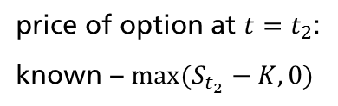



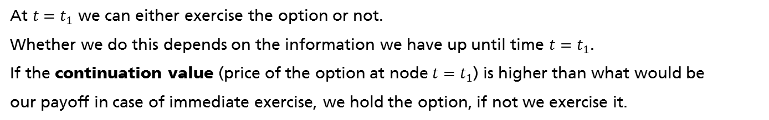




Backward Induction and American Monte-Carlo Methods
Backward induction – binomial tree cnt’d
American option is an option that can be exercised at any time between the trade start
and its contractual expiry.
option price at $t=0$
price of option at $t=t_{1}$:
price of option at $t=t_{2}$:
known – $max⁡(S_{t_{2}}−K,0)$
$$p$$
$${ H}_{uu}=max⁡(S_{0}u^{2}−K,0)$$
$$p$$
${V_{}^{u}=max⁡(e}^{−r∆t}[{pH}_{uu}+(1−p)H_{ud}$] $,max⁡(Su−K,0))$
$$V_{0}=…$$
$$1−p$$
$$H_{ud}=max⁡(S_{0}ud−K,0)$$
$$p$$
$$1−p$$
${V_{}^{d}=max⁡(e}^{−r∆t}[{pH}_{ud}+(1−p)H_{dd}$] $,max⁡(Sd−K,0))$
$$1−p$$
$$H_{dd}=max⁡(S_{0}d^{2}−K,0)$$
$$t=t_{0}=0$$
$$t=t_{1}$$
$$t=t_{2}$$
At $t=t_{1}$ we can either exercise the option or not.
Whether we do this depends on the information we have up until time $t=t_{1}$.
If the continuation value (price of the option at node $t=t_{1}$) is higher than what would be
our payoff in case of immediate exercise, we hold the option, if not we exercise it.

Slide 32
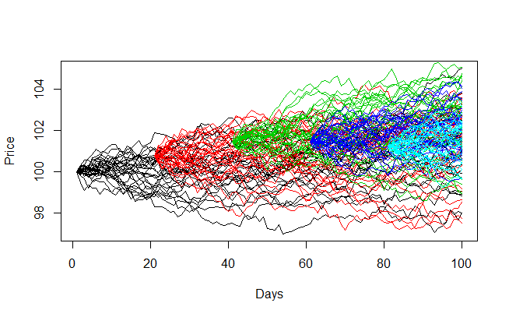
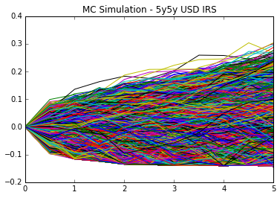

Backward Induction and American Monte-Carlo Methods
American Monte Carlo
$V_{n}$ = $h_{n}$ payoff at expiry
$V_{i}$= max{$h_{i}$, ${V_{i}}^{P}$} i < n
$h_{i}−payoff if we exercise at t_{i}$
How to compute the continuation value${{ V}_{i}}^{P}$?
Polynomial linear regression trick
$V_{i}≈P(t_{i}, t_{i+1})\left(ψ\left(O_{i}\right)\right)$, where $:$
$ψ$ is a polynomial function
$O_{i}$ are what we call the set
of observables
Nested Monte Carlo

Slide 33
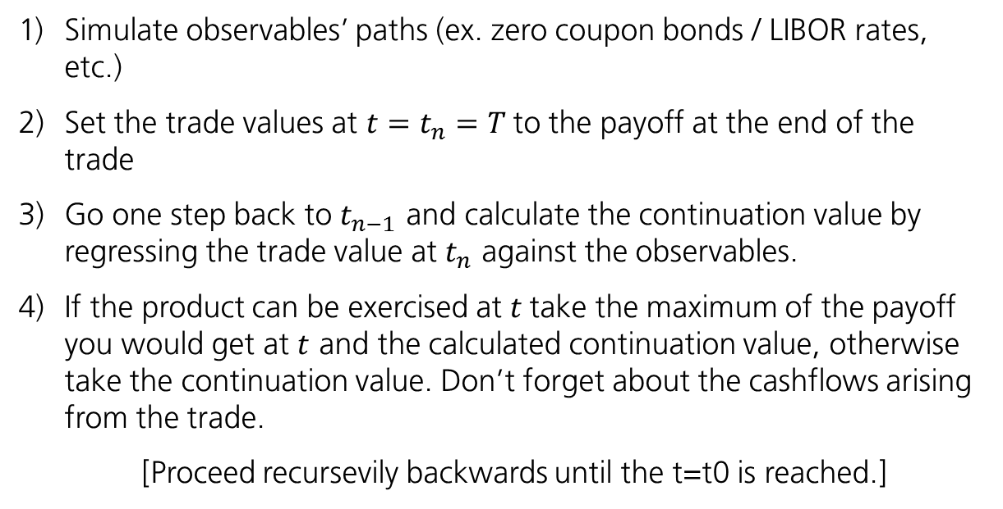
Backward Induction and American Monte- Carlo Methods
American Monte Carlo – step-by-step
Simulate observables’ paths (ex. zero coupon bonds / LIBOR rates, etc.)
Set the trade values at $t=t_{n}=T$to the payoff at the end of the trade
Go one step back to $t_{n−1}$ and calculate the continuation value by regressing the trade value at $t_{n}$ against the observables.
If the product can be exercised at $t$take the maximum of the payoff you would get at $t$ and the calculated continuation value, otherwise take the continuation value. Don’t forget about the cashflows arising from the trade.
[Proceed recursevily backwards until the t=t0 is reached.]
*Easy to follow example given at:
Longstaff, Schwartz; Valueing American Options in Simulations: A simple least-square aproach;
(The review of financial studies, Vol14, No1, 2001.)

Slide 34
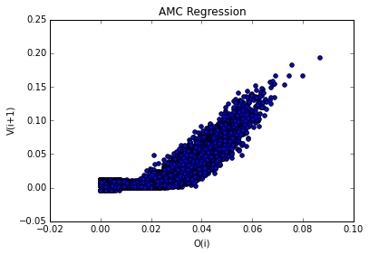
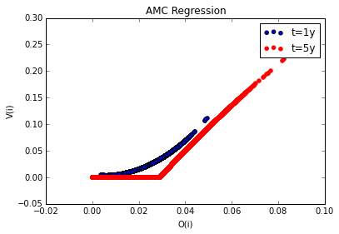
Backward Induction and American Monte-Carlo Methods
AMC Regression Results

